Slide 1
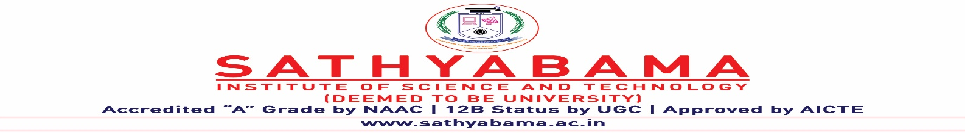
PROJECT MANAGEMENT AND MAINTENANCE
Under the guidance of
Dr. J. Albert Mayan, ME, Ph.D.,
by
Hariharan B P
(39110373)
Jagadeesh N
(39110393)
Mohnish Devaraj
(39110636)

Slide 2
Presentation Outline
Aim and Problem statement
Introduction
Literature Review
Inferences from Literature Review
Problems for existing system
Objectives
Ideation Map
Flow Diagram and System Architecture
Process
Description of Software for Implementation
Project Management Plan
Future Implementation
Budget
Application Screenshots
References

Slide 3
Aim and Problem statement
AIM:
- To collect the project details of the students and selection of the guide for the project, upload the documents related to the project.
PROBLEM STATEMENT:
- To create a system to reduce manual work in the process of Guide selection, collection and maintenance of student and project details as well as the project reports.
The students can select the Guide of their choice which makes the interaction between the student and faculty much easier and make the process smoother.
The guides can review the Project details of the team, and have the options to approve or disapprove.

Slide 4
Introduction
This application is a web-based portal that allows the students to register themselves and select their guide for the final year project.
The students can register their team using email, name, and project details such as project name, project domain, and Project Description.
The students can choose the guide based on the availability of the guide, and the details of their team will be emailed to the student(s) containing the project details via SMTP protocol.
The team will receive the Unique Team ID(Eg. CSE-000). This team id will be used for the login purposes.

Slide 5
Literature Review
AUTHOR | YEAR OF PUBLICATION | DESCRIPTIONS | PROS | CONS
Shahnawaz | 2019 | The system to record activities of the project in graphic detail on GIS map with geo-coded images and to create a digital representation of the entire project rollout. This digital representation becomes a valuable resource for operation and maintenance on completion of the project rolls out, the progress can be seen on an intuitive GIS based dashboard | The system provides multiple methods of data entry: web interface, spreadsheet and mobile application. | Can be used for corporate projects and way beyond the understanding of a student

Slide 6
Literature Review
AUTHOR | YEAR OF PUBLICATION | DESCRIPTIONS | PROS | CONS
Zhang Yan, Guo Wei, Liu Dongdong, Niu Lei, Yan Mengran | 2020 | The system includes project application and review module, project opening management module, project completion management module and project research results display module and project declaration, opening report, progress report and conclusion report and network review | Research oriented project tracking | Not friendly for software oriented projects

Slide 7
Inferences from Literature Survey
We inferred that the issues faced such as duplication in users, unlimited guide repetitions, multiple logins and Unnecessary to edit details.
So the system was made by understanding these issues and implemented certain strategies and limitations in the backend to avoid these duplication and login issues in the future.
The other main issue was the user interface and the compatibility on devices, which is also been solved and implemented using better UI/UX and media queries.
This project is mainly considered for the PC platform since it was software based but it was planned and implemented in a web -based portal.
This web portal was built by resolving the issues, and make it a user-friendly platform.

Slide 8
Problems for existing system
Data Duplication
Repeated Login
Un-authorized changes
Complicated UI
Security Issues
Scalability issues
Cross platform issues
Manual work
Non -Transparent process
Server crowd and Accessing speed

Slide 9
Objectives
This web based portal can be used by educational institutes or colleges to maintain the projects of students easily.
This Portal allows online submission of student Project details, files and selection of the guide.
Achieving this objective is difficult using a manual system as the information is scattered, the time complexity will be higher.
This Portal will store the details of the students such as student details, Project details, guide selected, guide details, project files.

Slide 10
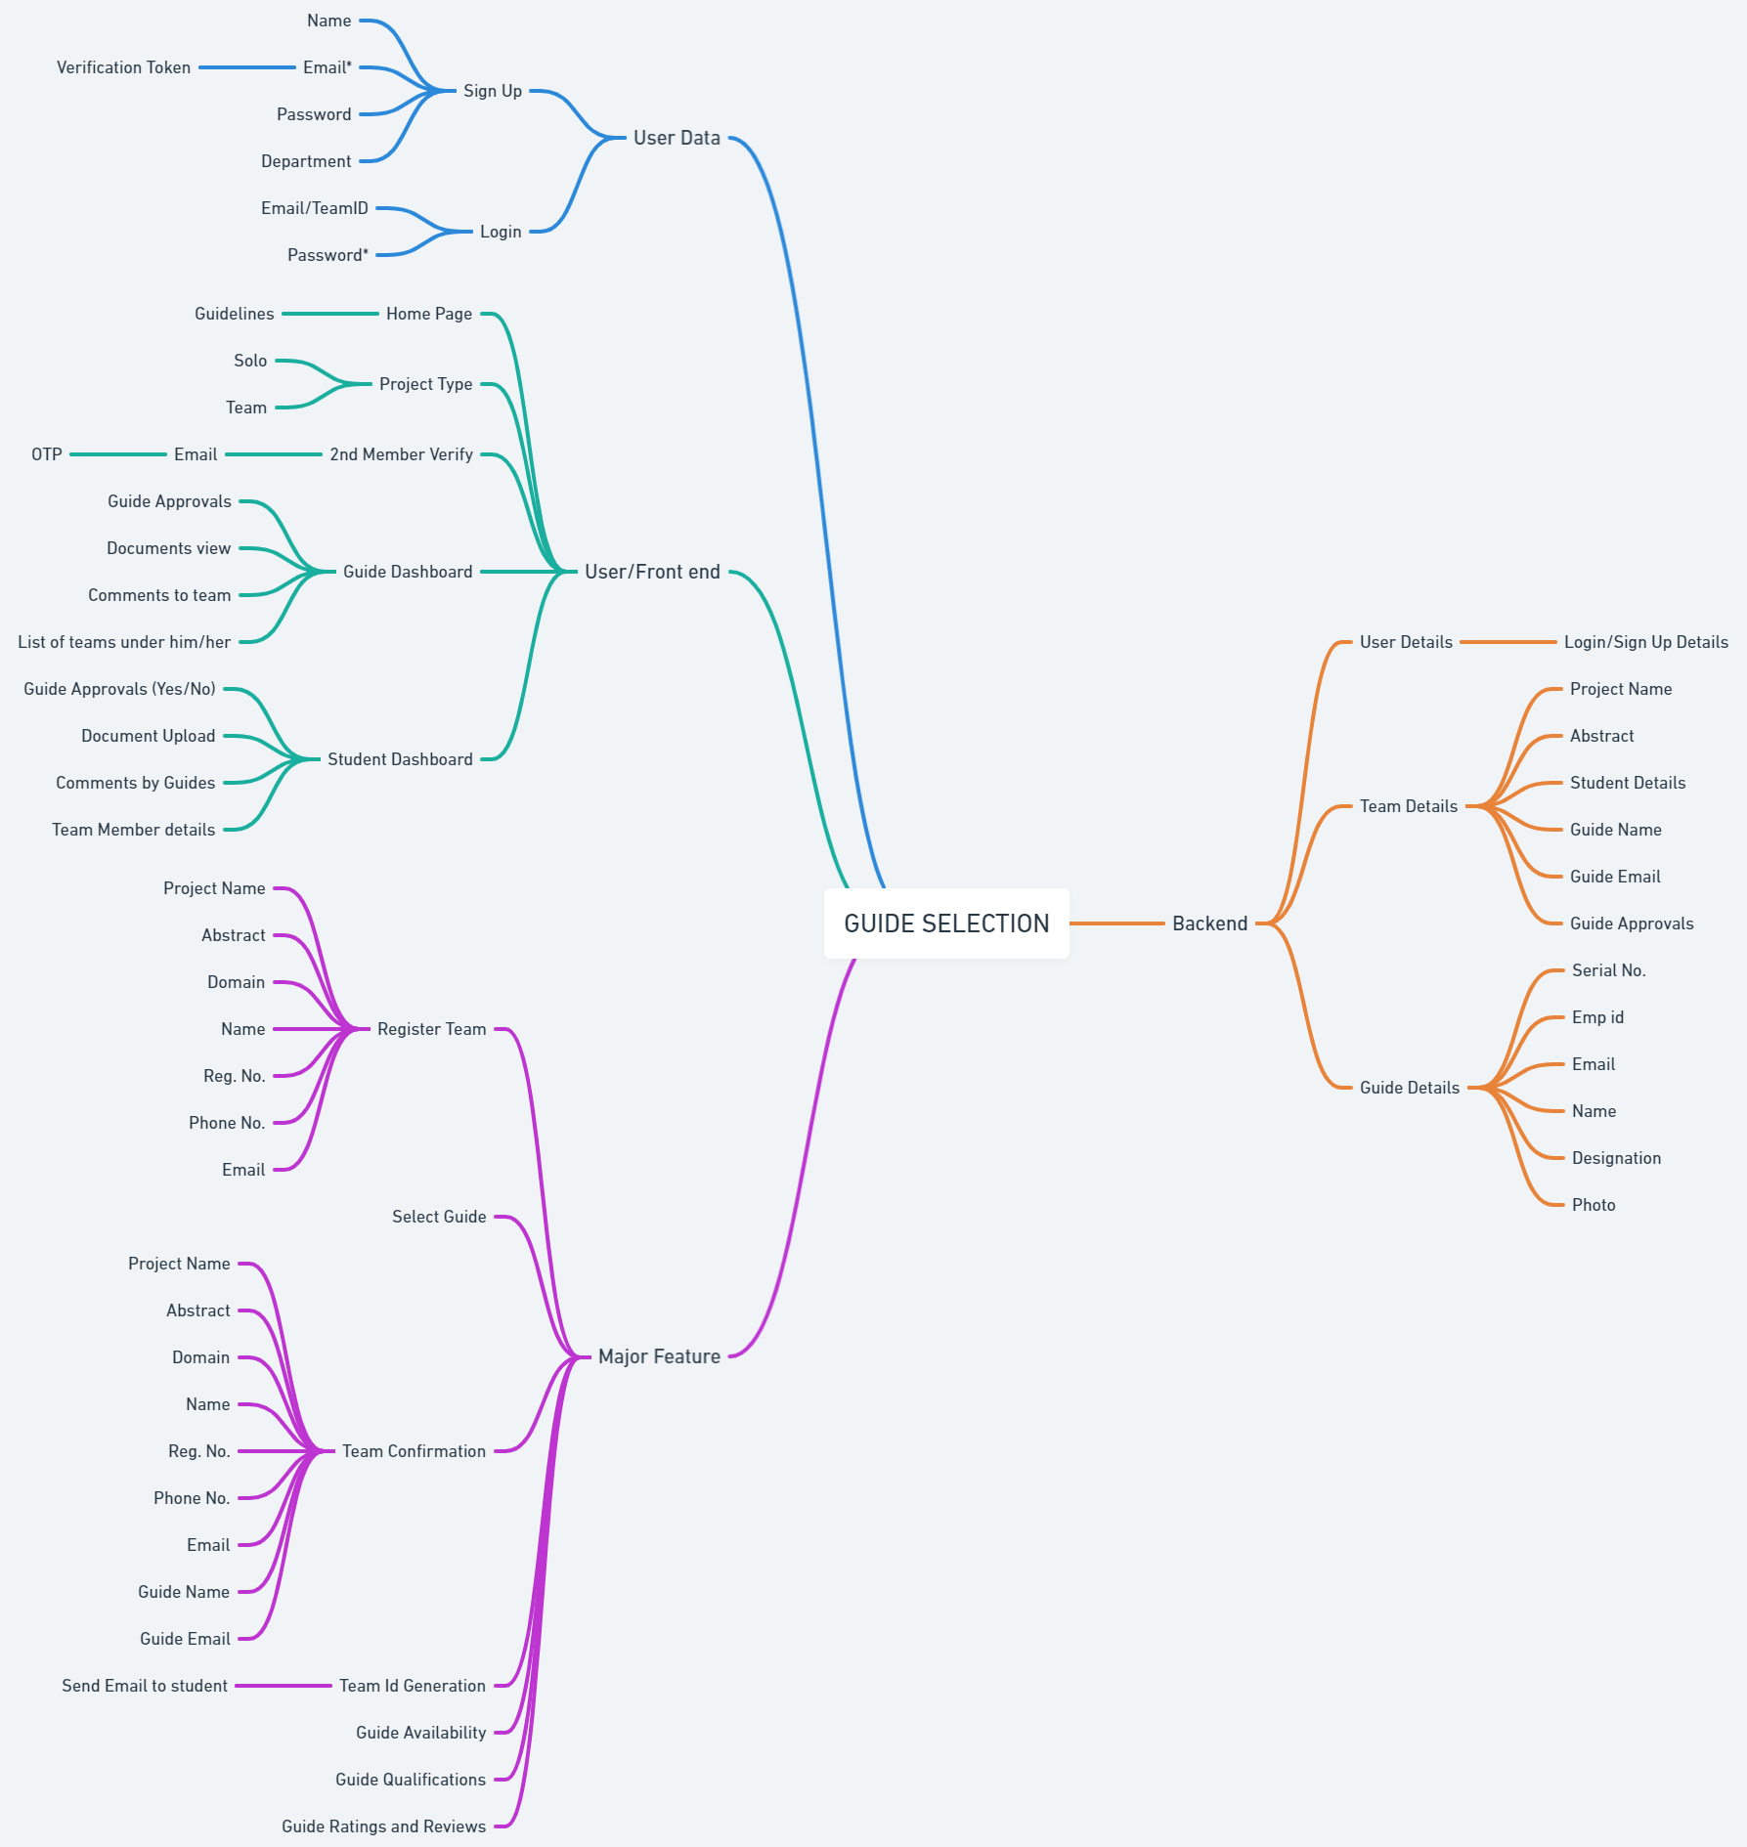
Ideation Map

Slide 11
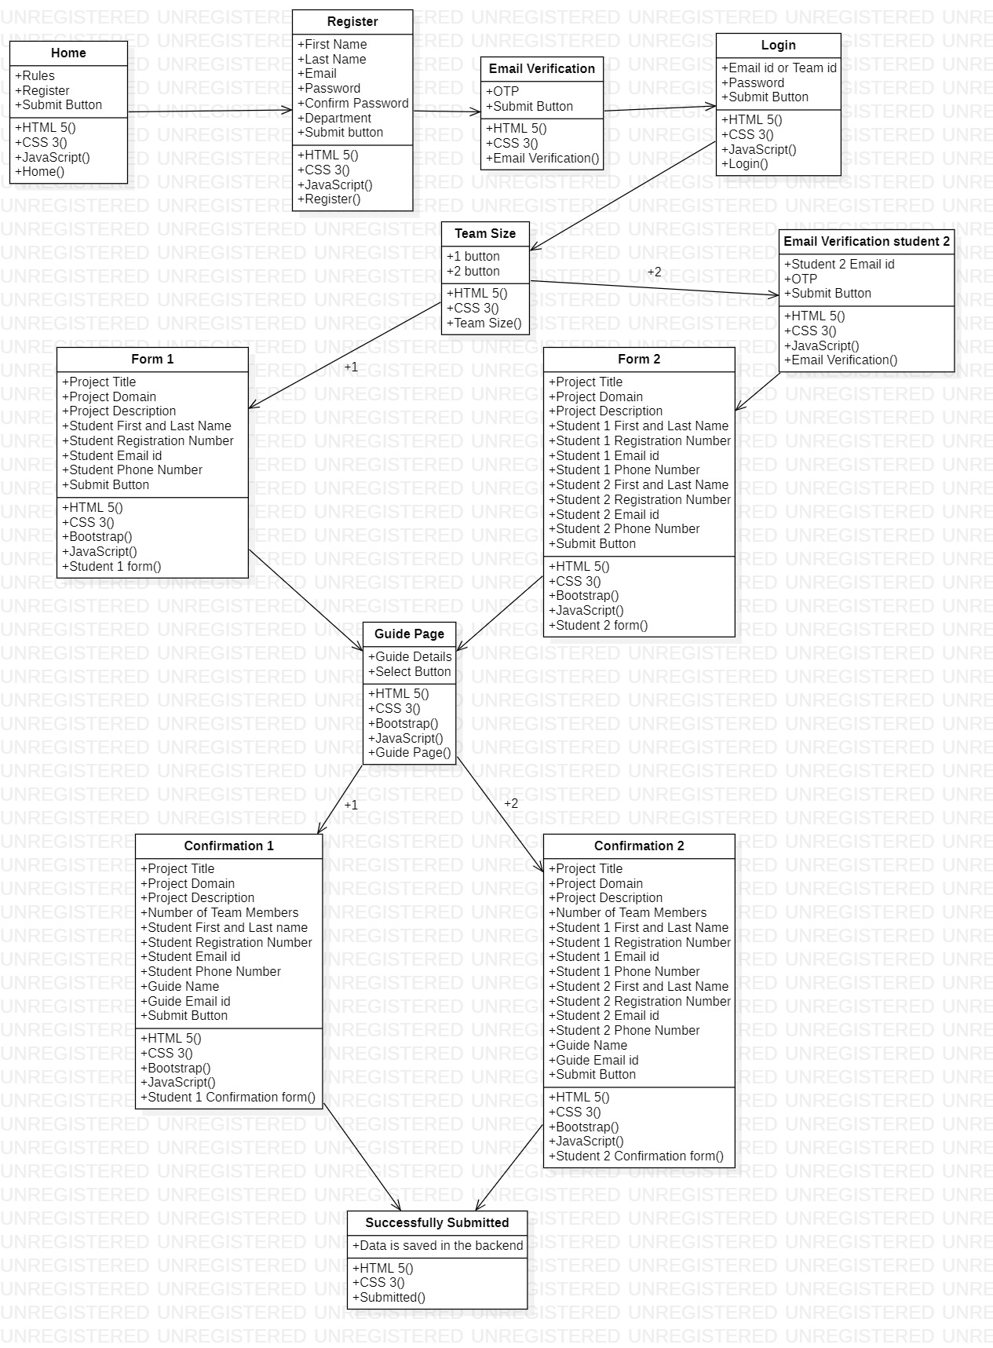
System Architecture

Slide 12
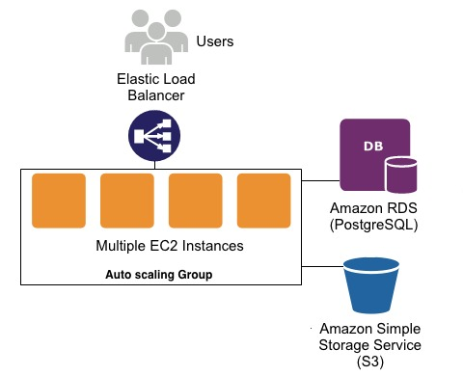
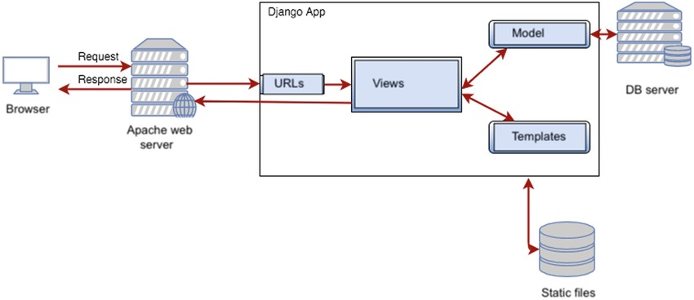
System Architecture

Slide 13
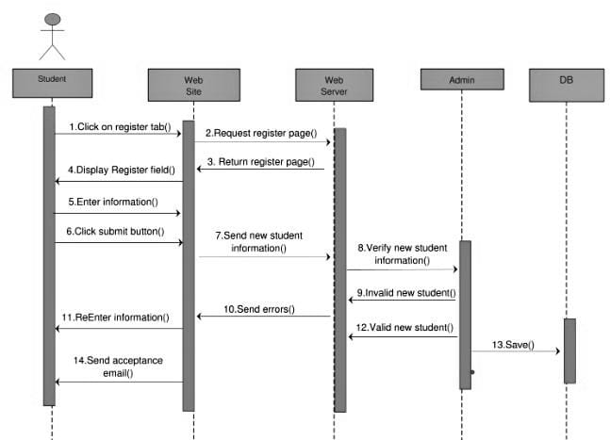
Block Diagram

Slide 14
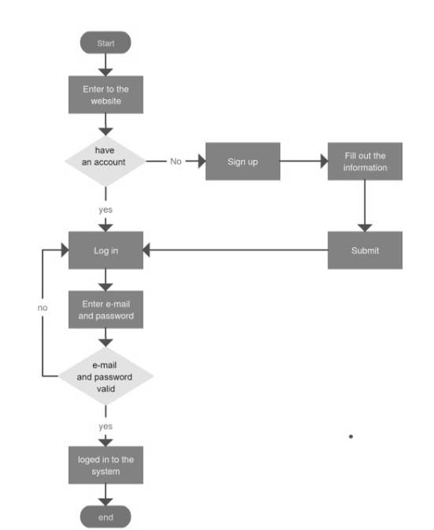
Flow Diagram

Slide 15
Process for Final year project Registration
Register
Register using Name, email id, password
OTP is generated to the given mail id, and verifies the email id
Login
Login using email id and password
Select the team size
Select the total number of students, one member or two members
If two members, second team member mail id should also be verified using OTP.
Fill the Project details
Fill the form which consists of Project Title, Project Domain, Project Description, and details of the student(s) such as Name, Email, Registration Number and Mobile Number.

Slide 16
Process for Final year project Registration
Selecting of the Guide
Students need to select the guide
Confirmation Page
This page will consists of all the details filled by the user, which allows the user to check the details entered.
Submission
This is the final page, where the details have been stored in the database.

Slide 17
Description of Software for Implementation
Front-end: HTML 5, CSS 3, Bootstrap, Java Script
Back-end: Django(Python)
Database: Postgres
Hosting: Railway
Domain: GoDaddy
SSL: Cloudflare
Cloud: AWS(Amazon Web Service)

Slide 18
Modules
Psycopg2:- A plugin for connecting backend Django with postgresql database and performing the query operation.
Send_email():- A Django.email plugin to send auto-generated email from the server to the user regarding the status of his/her submission.
Django-Heroku:- A Heroku plugin for connecting the Heroku cloud base with our local Application.
Gunicorn:- Determines what type of Web Application it is i.e. identifies it as WSGI(Web Server Gateway Interface) or ASGI (Asynchronous Server Gateway Interface) and acts as a medium to serve requests from Heroku cloud server to web application in the backend.

Slide 19

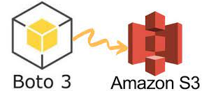
Modules
Django-storages:- django-storages is a project to provide a variety of storage backends in a single library. This library is usually compatible with the currently supported versions of Django. Check the Trove classifiers in setup.py to be sure.
Boto3 and AmazonS3: Boto3 is an AWS SDK for python to create, configure, and manage AWS services, such as Amazon Elastic Compute Cloud (Amazon EC2) and Amazon Simple Storage Service (Amazon S3). The SDK provides an object-oriented API as well as low-level access to AWS services

Slide 20
Project Management Plan
Planning:
Discussion with dean mam and professors
Designing:
Used Figma for designing
Development:
Used VS code
Testing:
3 Testing were done
Deploying:
Was Deployed in Heroku, currently running in Railway hosting and used GoDaddy for Domain

Slide 21
Project Management Plan
The project registration and guide selection is a module for the final year and it is deployed in Railway.
The Guides have to register and create an account, so that the guides can review the project details of the team.
This modules helps in maintaining the projects done by the students with ease. The department's work is greatly facilitated as well as the student’s.

Slide 22
Project Management Plan
Added cloud storage which collects all the project documents , ppt, guide form and research paper.
This projects is used by the department to collect the student details, project details, guide details and to check and review the ppt and documentation.
The Guide will be able to approve the student details, documentation, PPT and research paper of the project.
The staffs can also give the comments, suggestions and remarks on the project, which the students can also review it.

Slide 23
Future Implementation
Improve the UI and UX
Provide updates and reduce bugs
Build a real time communication system
Improve user friendliness
Implement news/announcement and event pages
Implement the super admin(almost completed)

Slide 24
Budget
Total Cost Spent Till Now:
1.Go daddy domain: Rs:900 for 2 years
2.Heroku: Rs:00 (free of cost for now)
3.SSL key: Rs:00 (free of cost for now)
Cost required in future:
1.Railway Hosting: Rs:2100 + tax per month
2.cloud storage: (AWS :S3 standard :Rs:500 + tax per month) (preferred)
(Google cloud: 200GB : Rs : 210 per month)
3.Domain renewal: Rs:1200 per year
4.SSL certificate: (basic: Rs :349 per month)
(Intermediate: Rs : 749 per month) (preferred)
Overall Budget Required :
-The overall cost required for system maintenance per year is approximately Rs:25000 (per year).

Slide 25
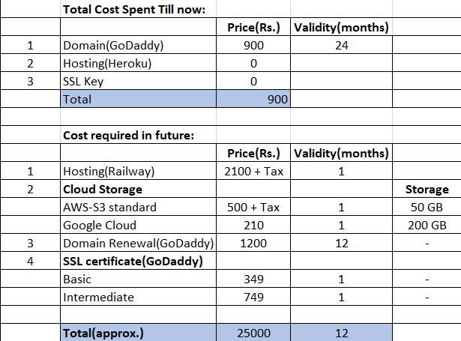
Budget

Slide 26
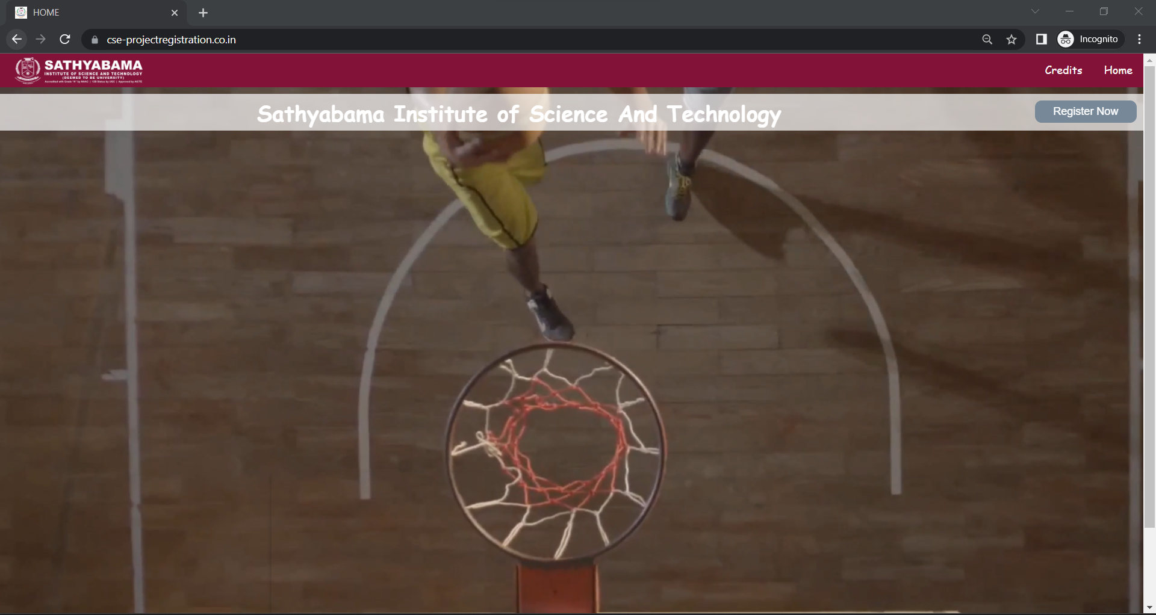
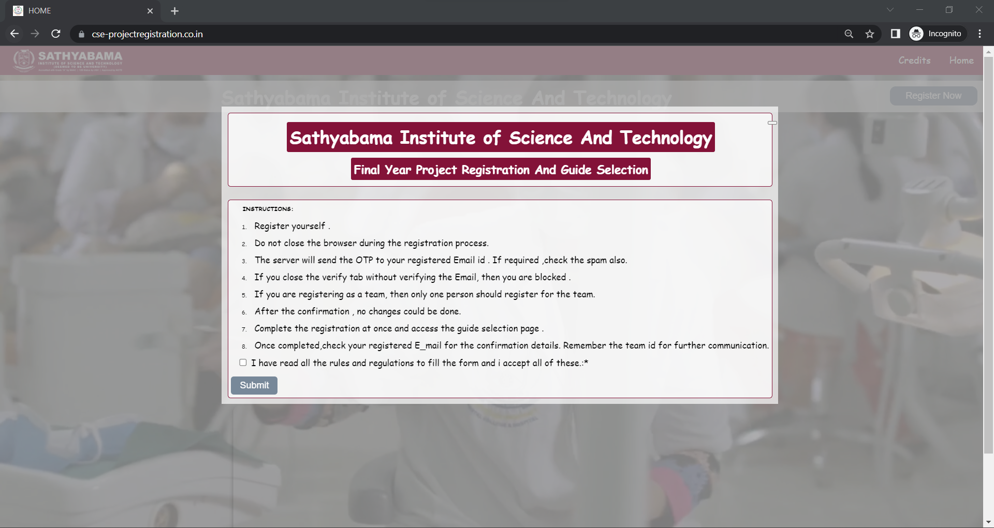
Application Screen shots

Slide 27
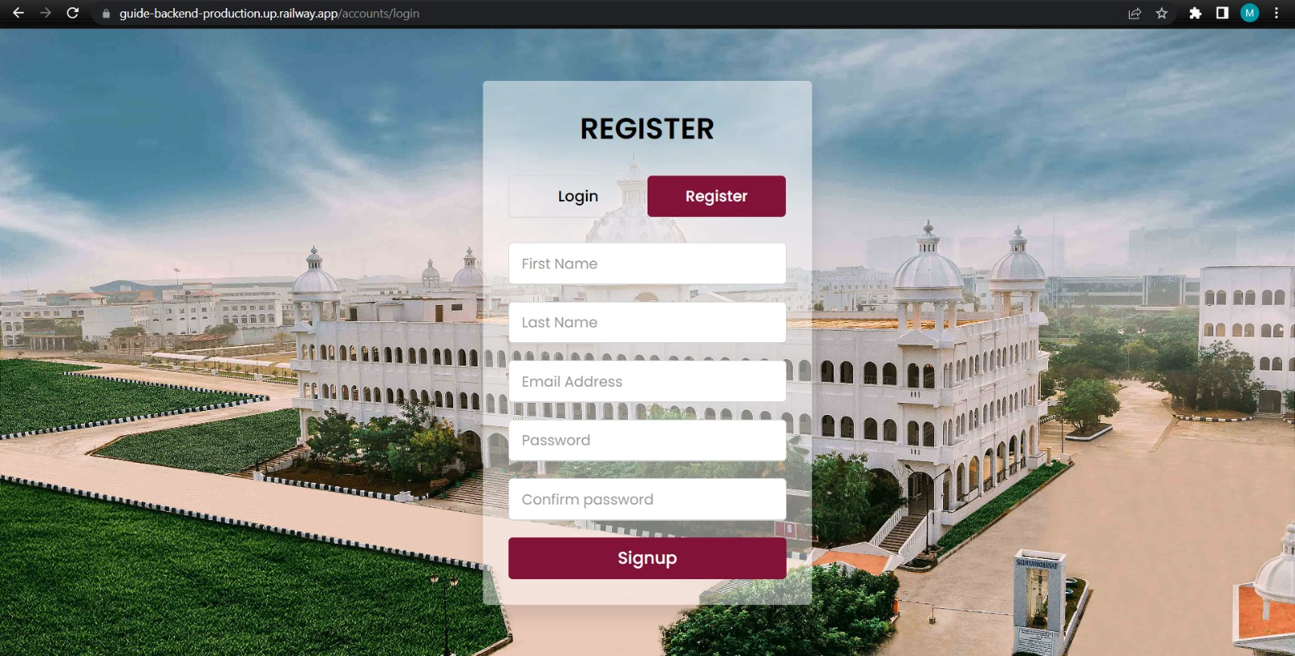
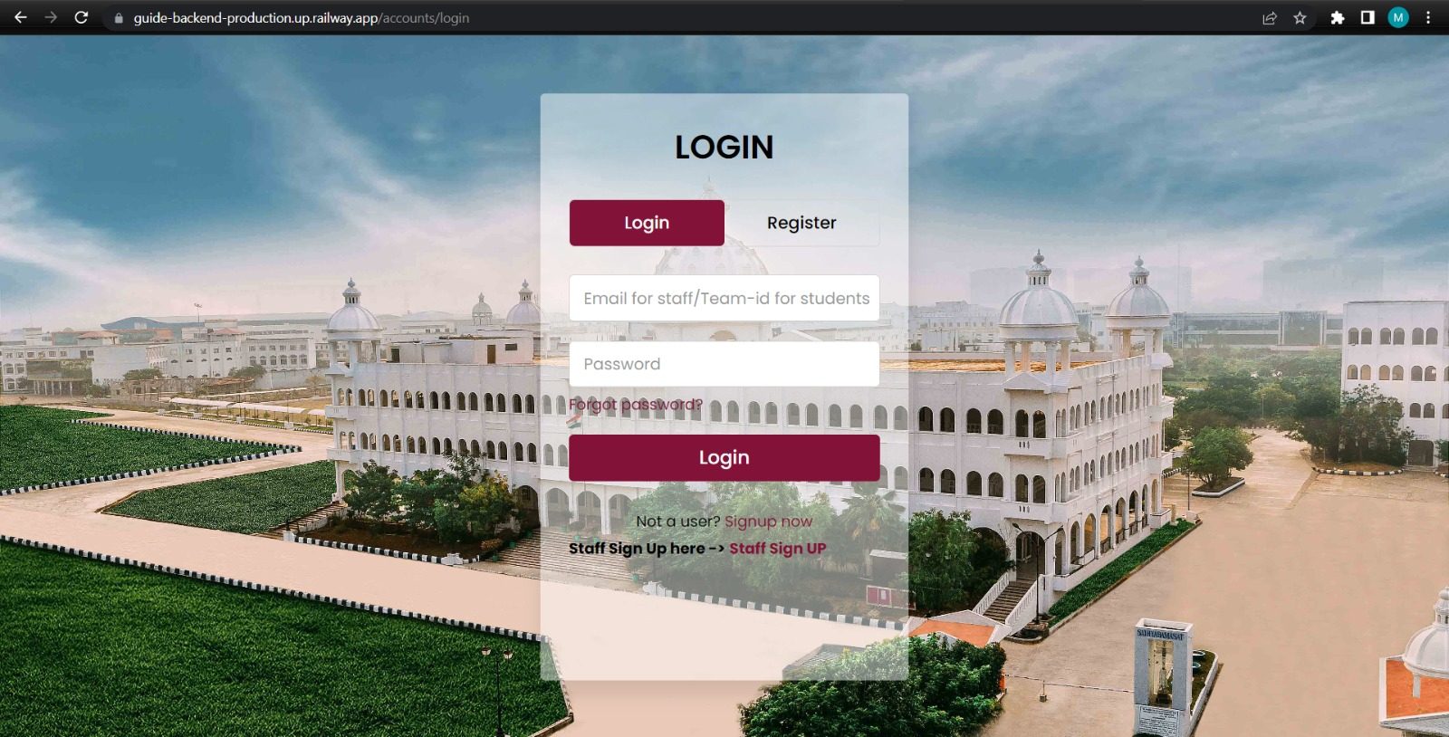
Application Screen shots

Slide 28
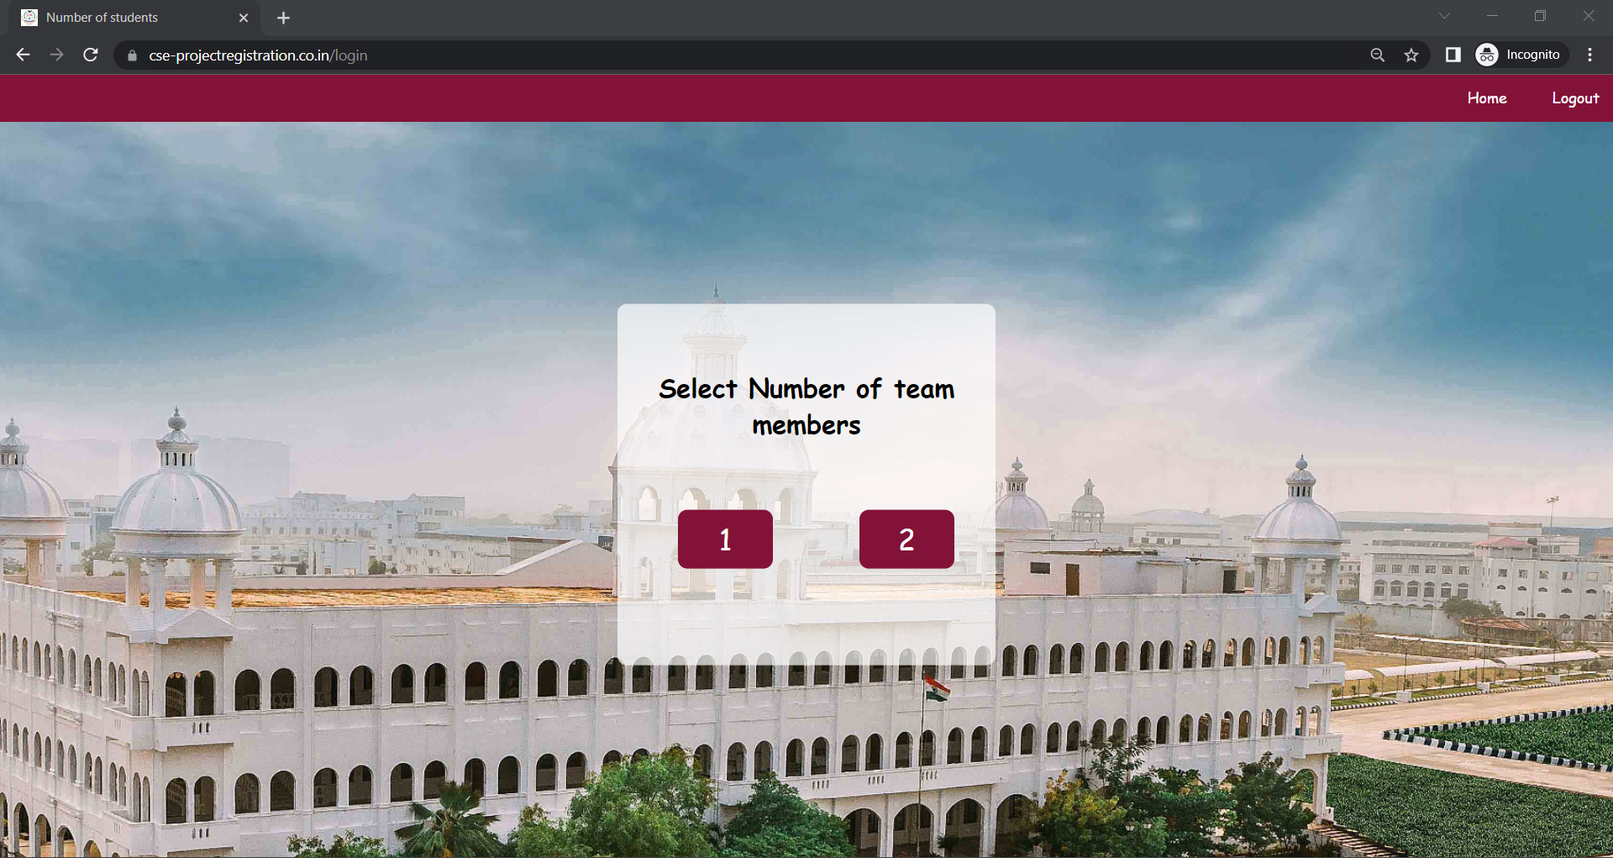
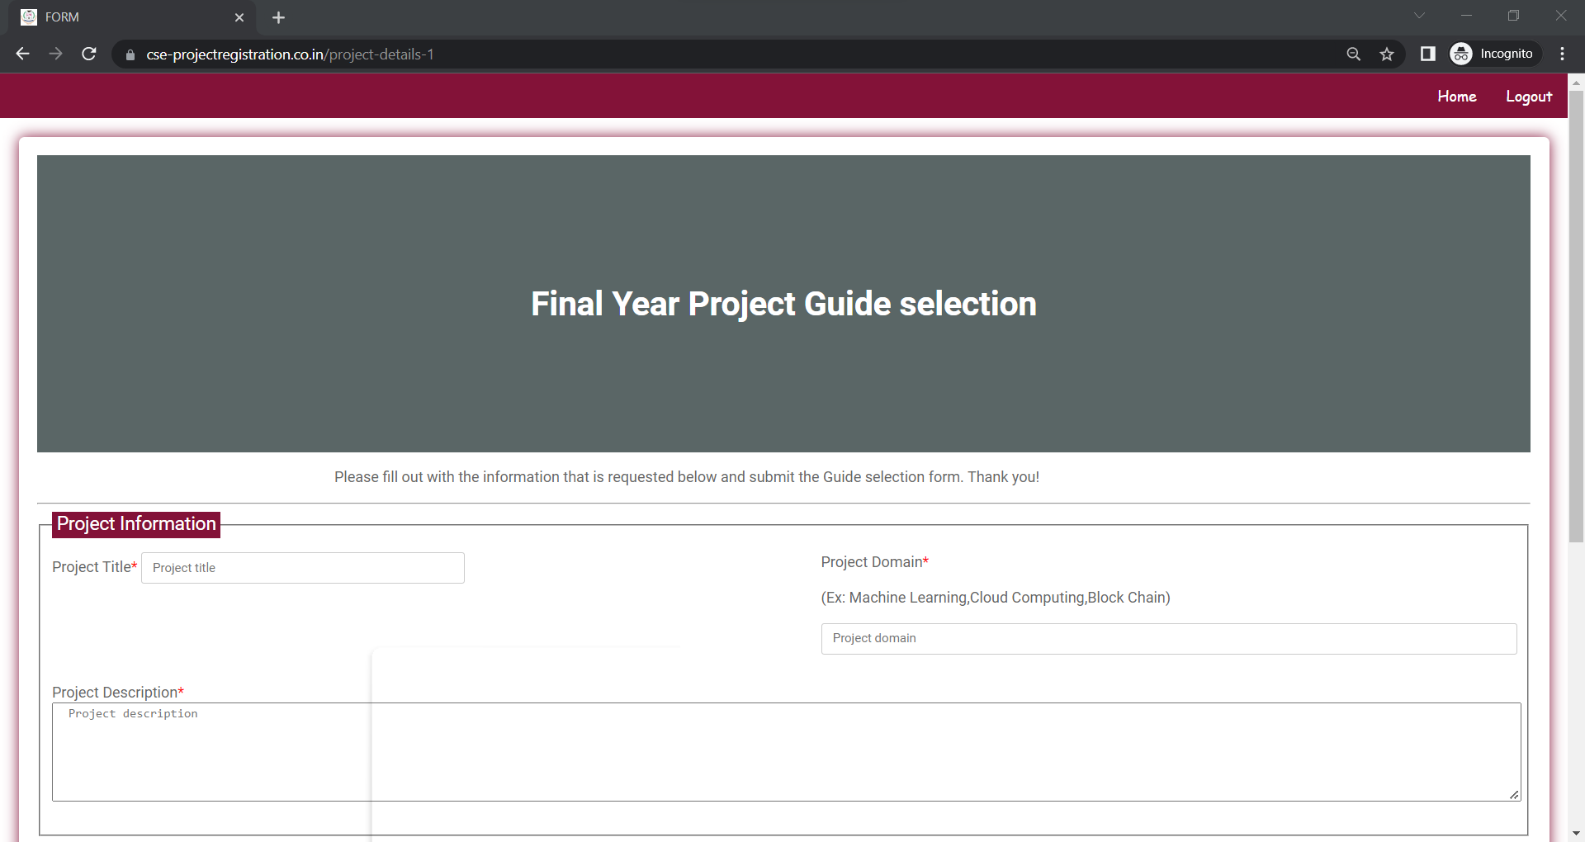
Application Screen shots

Slide 29
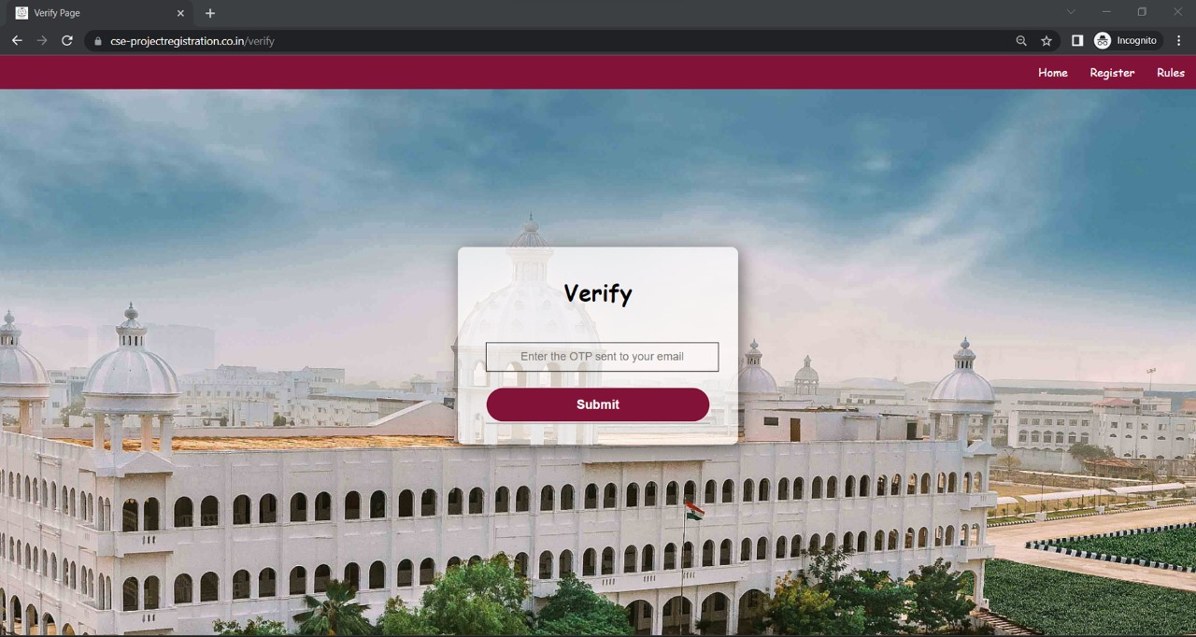
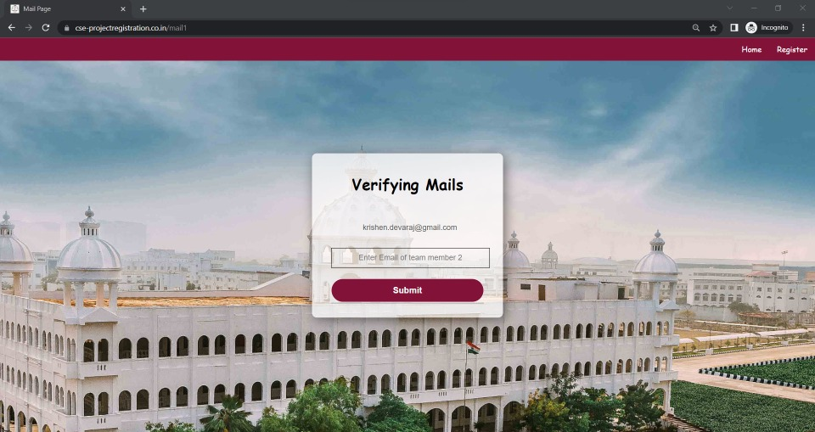
Application Screen shots

Slide 30
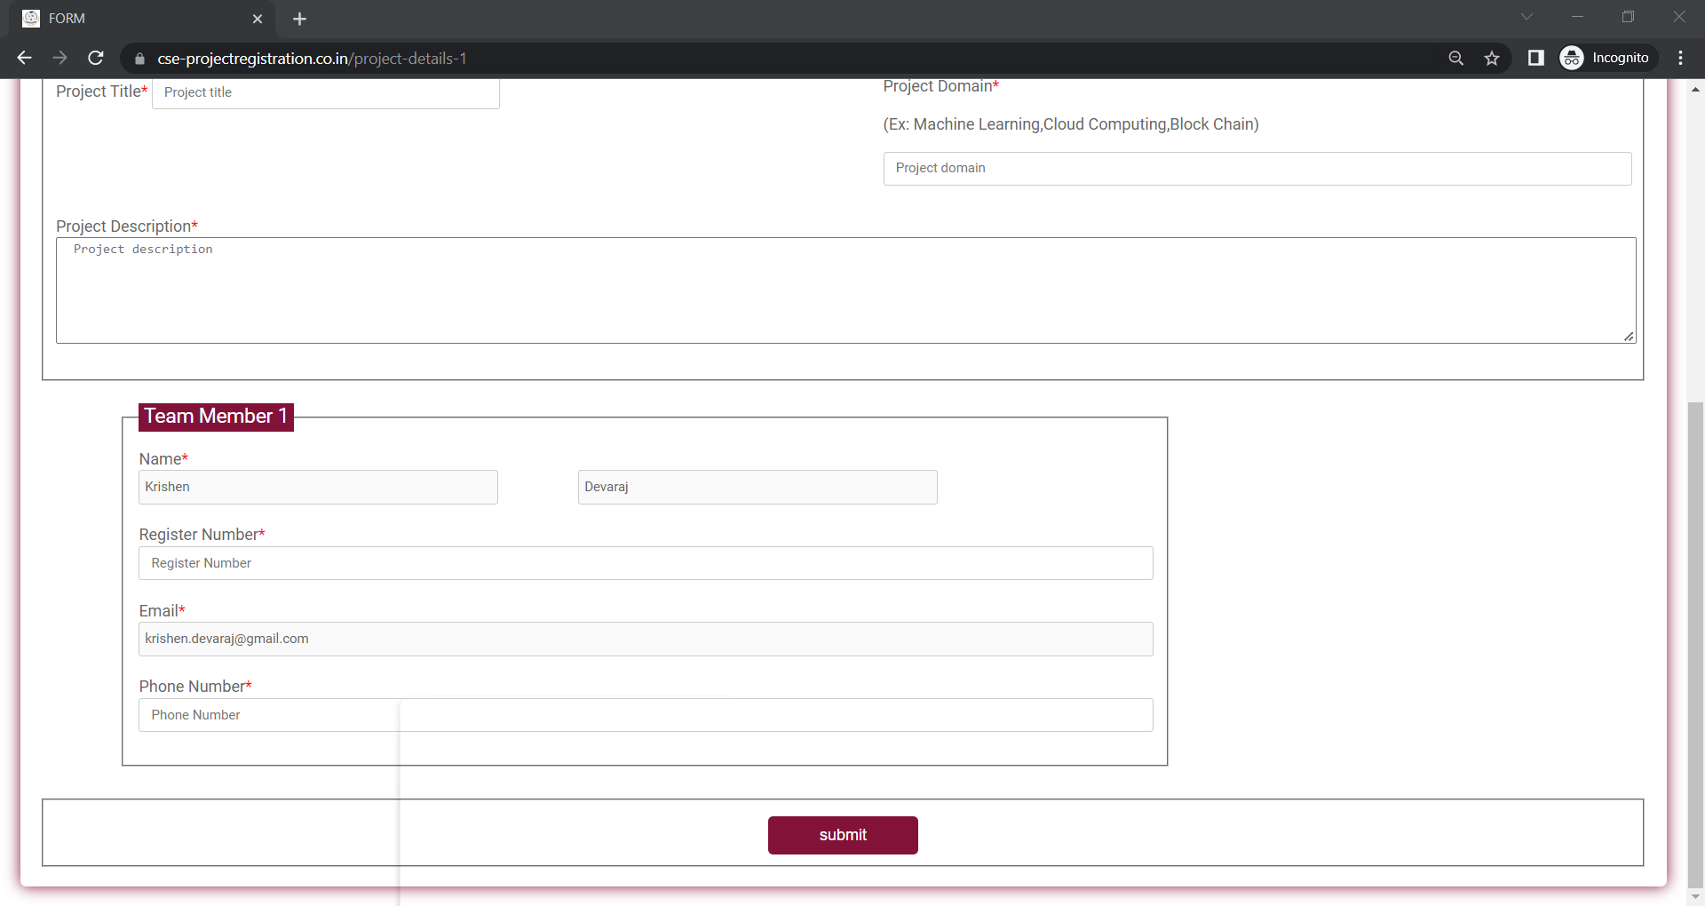
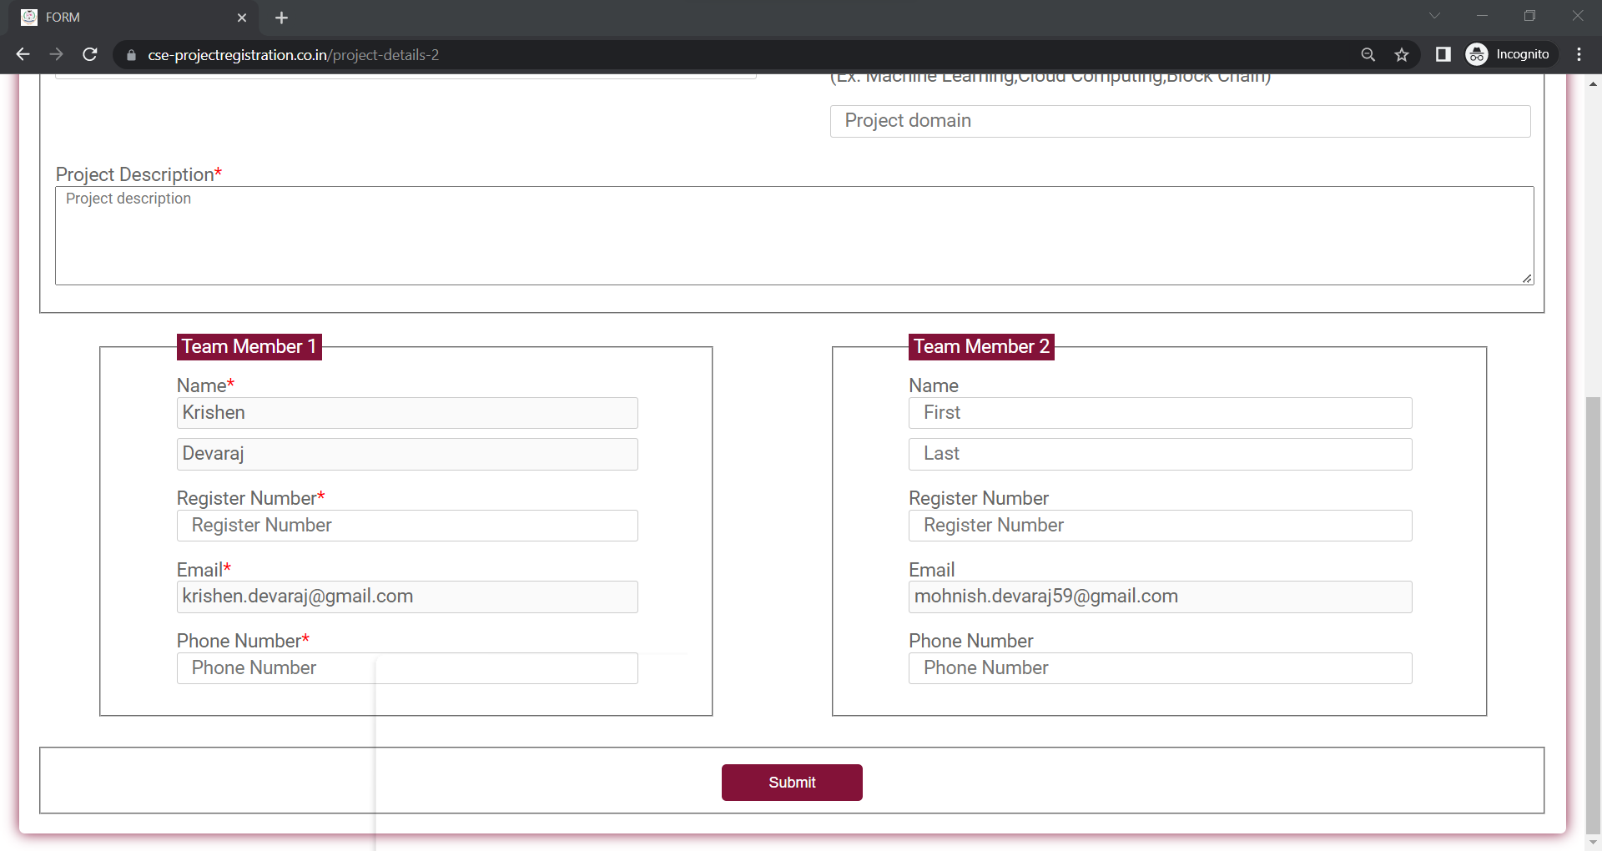
Application Screen shots

Slide 31
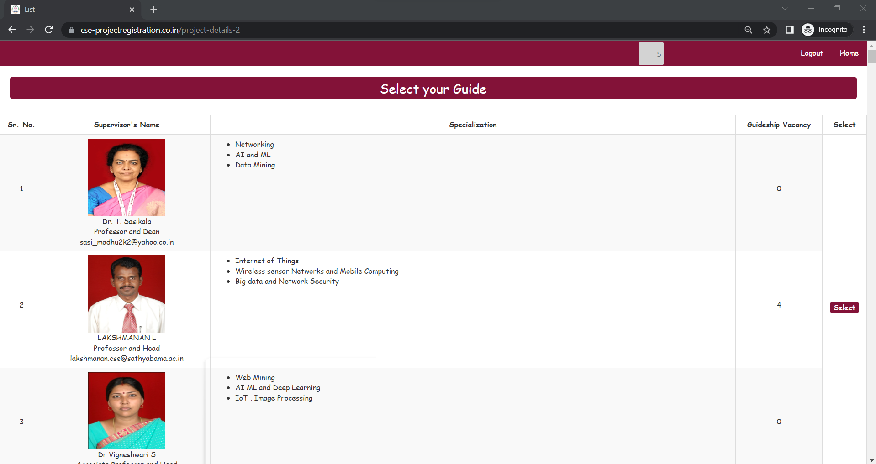
Application Screen shots

Slide 32
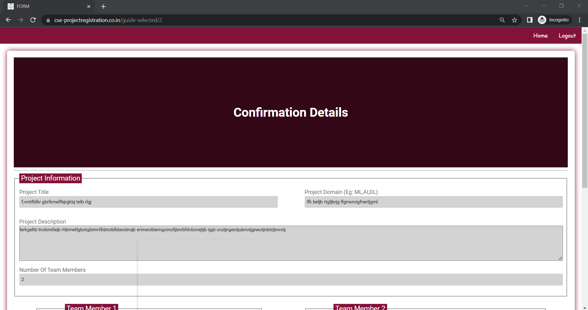
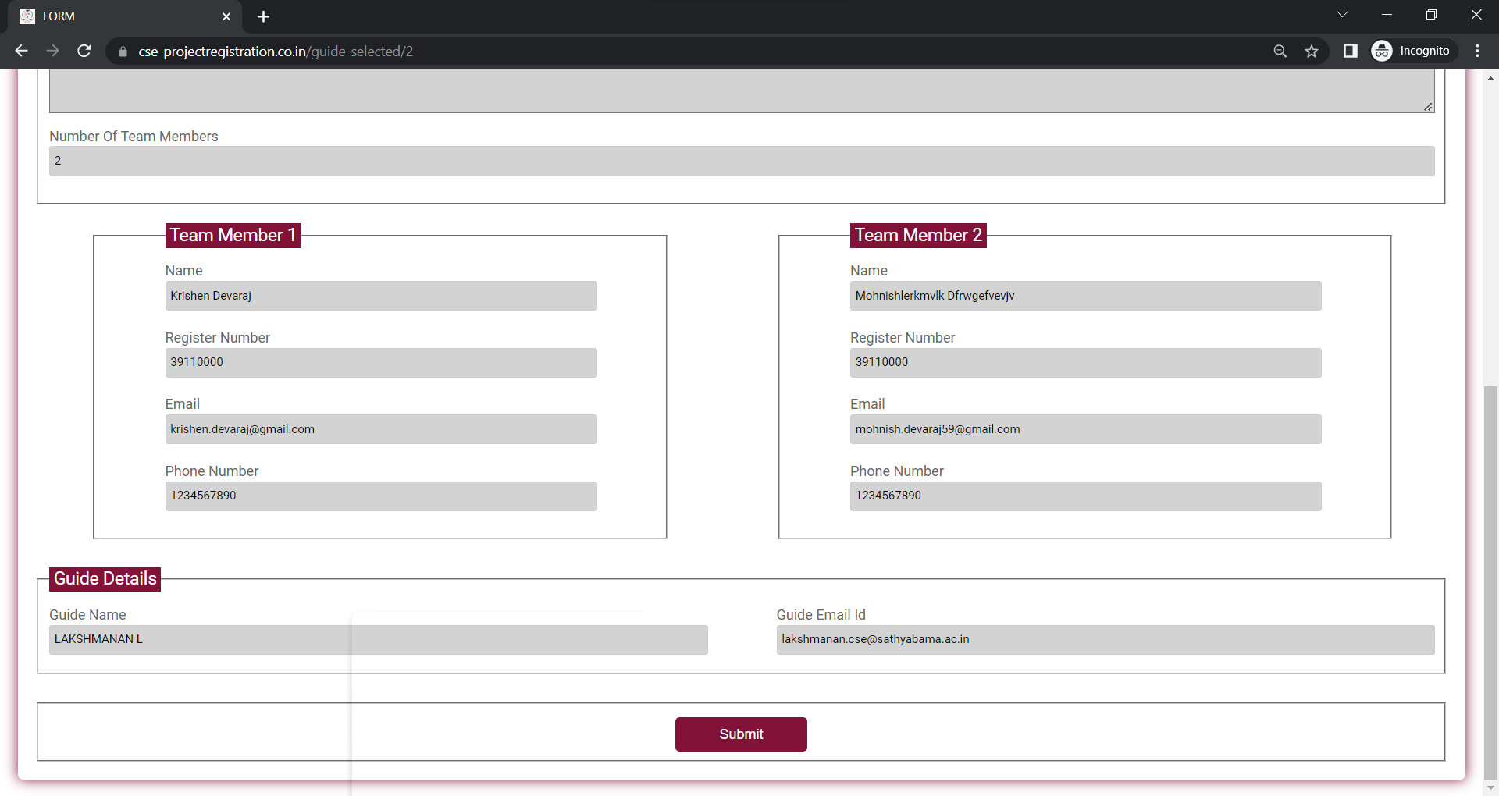
Application Screen shots

Slide 33
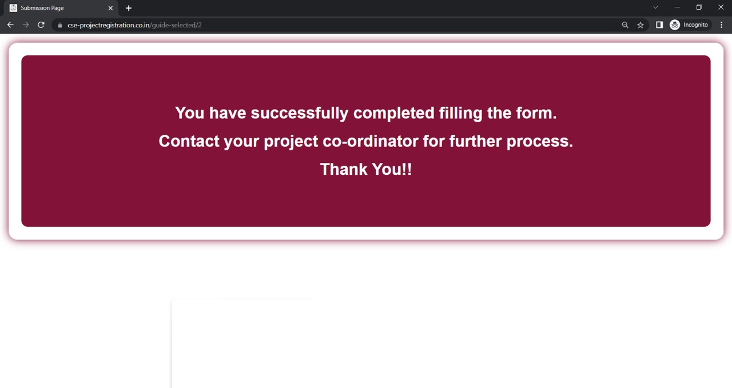
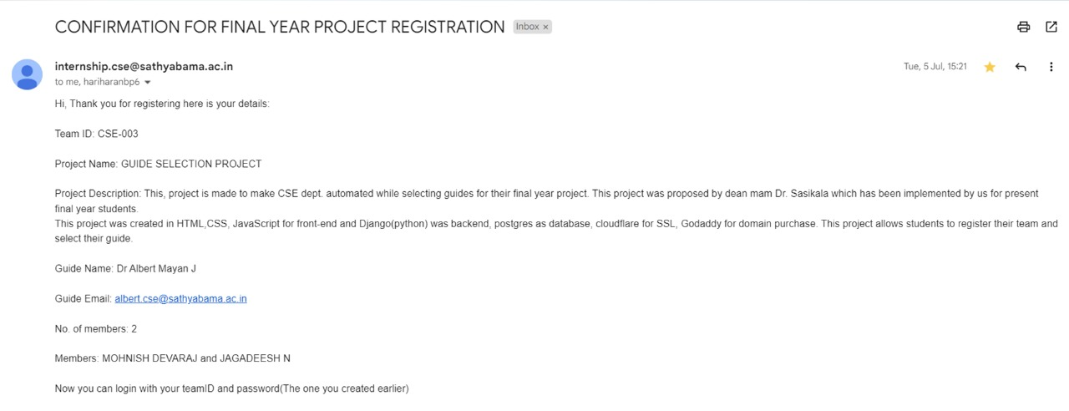
Application Screen shots

Slide 34
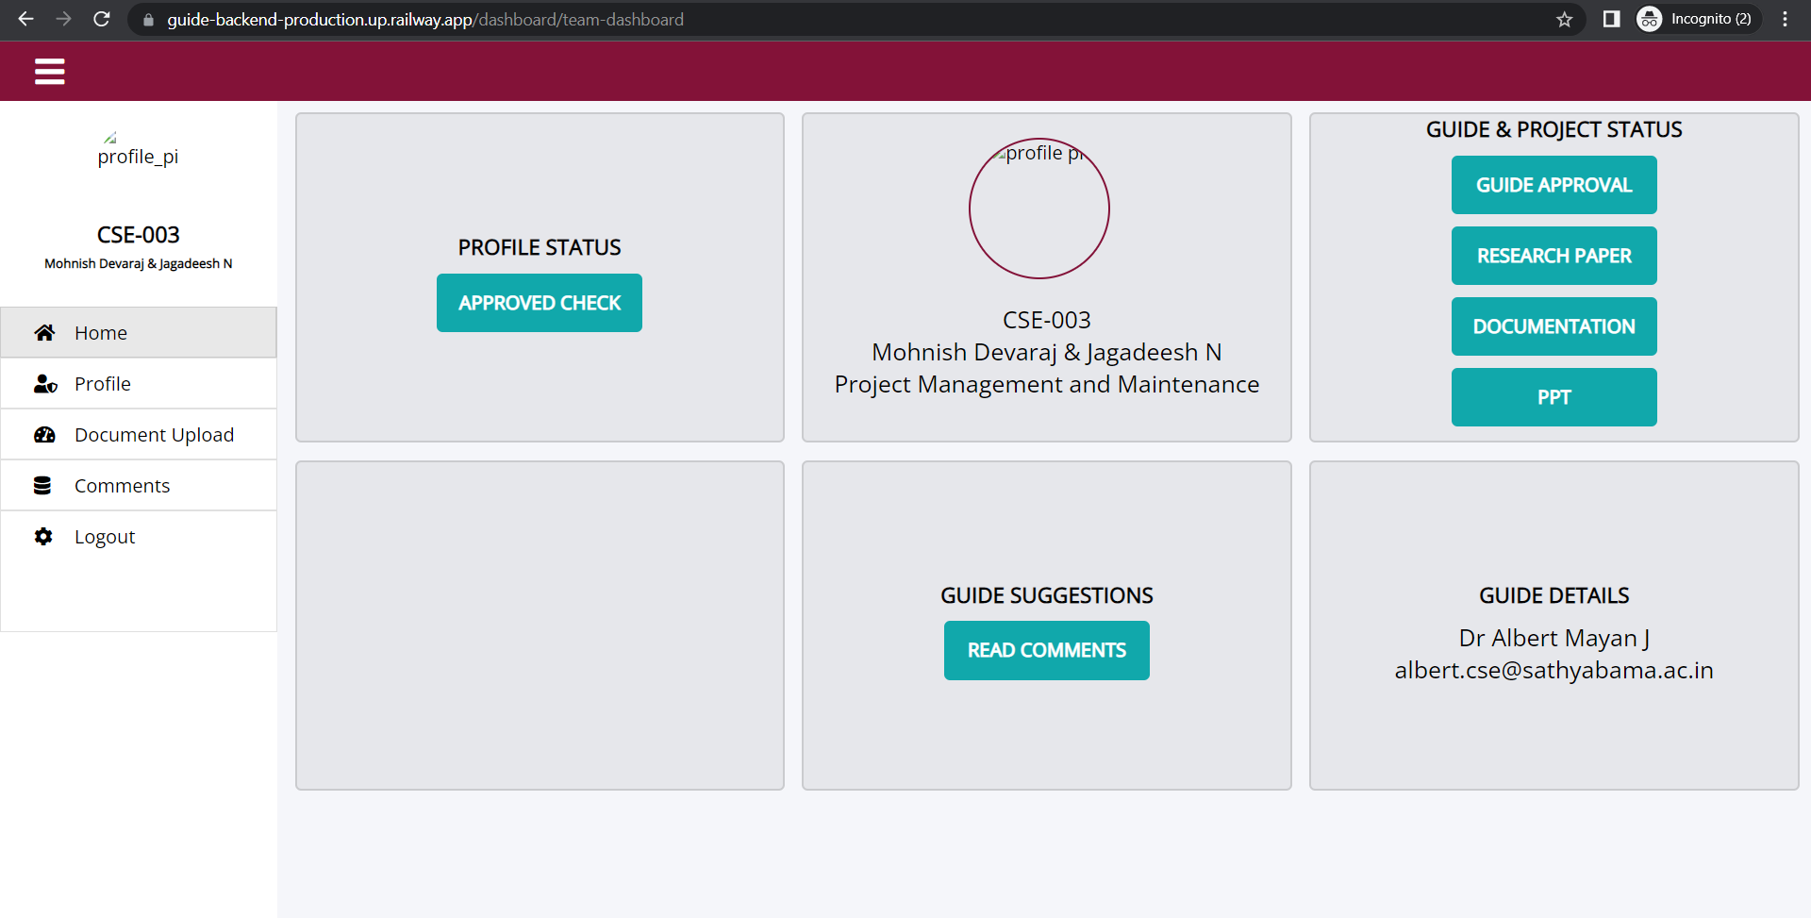
Application Screen shots

Slide 35
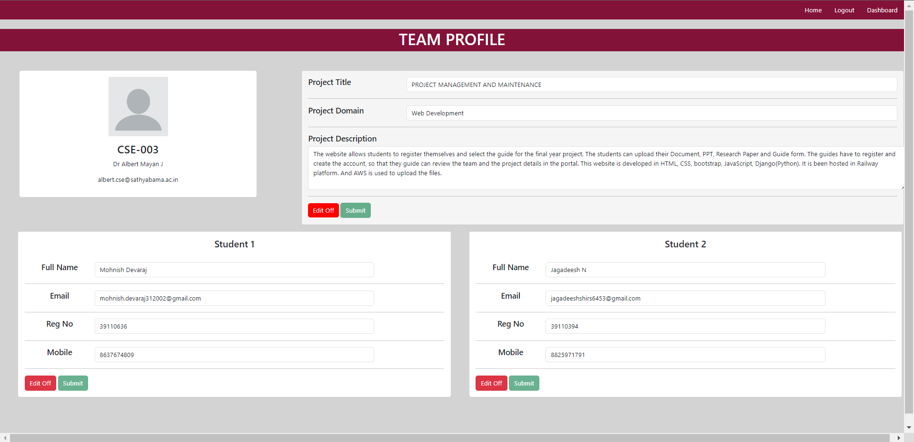
Application Screen shots

Slide 36
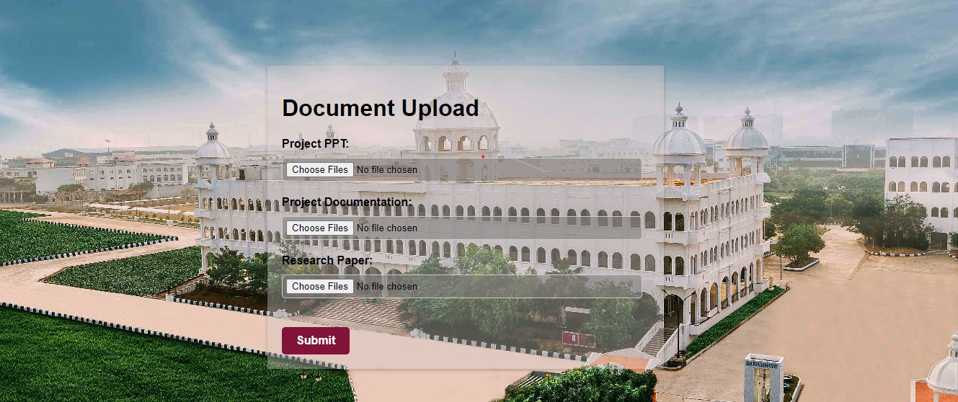
Application Screen shots

Slide 37
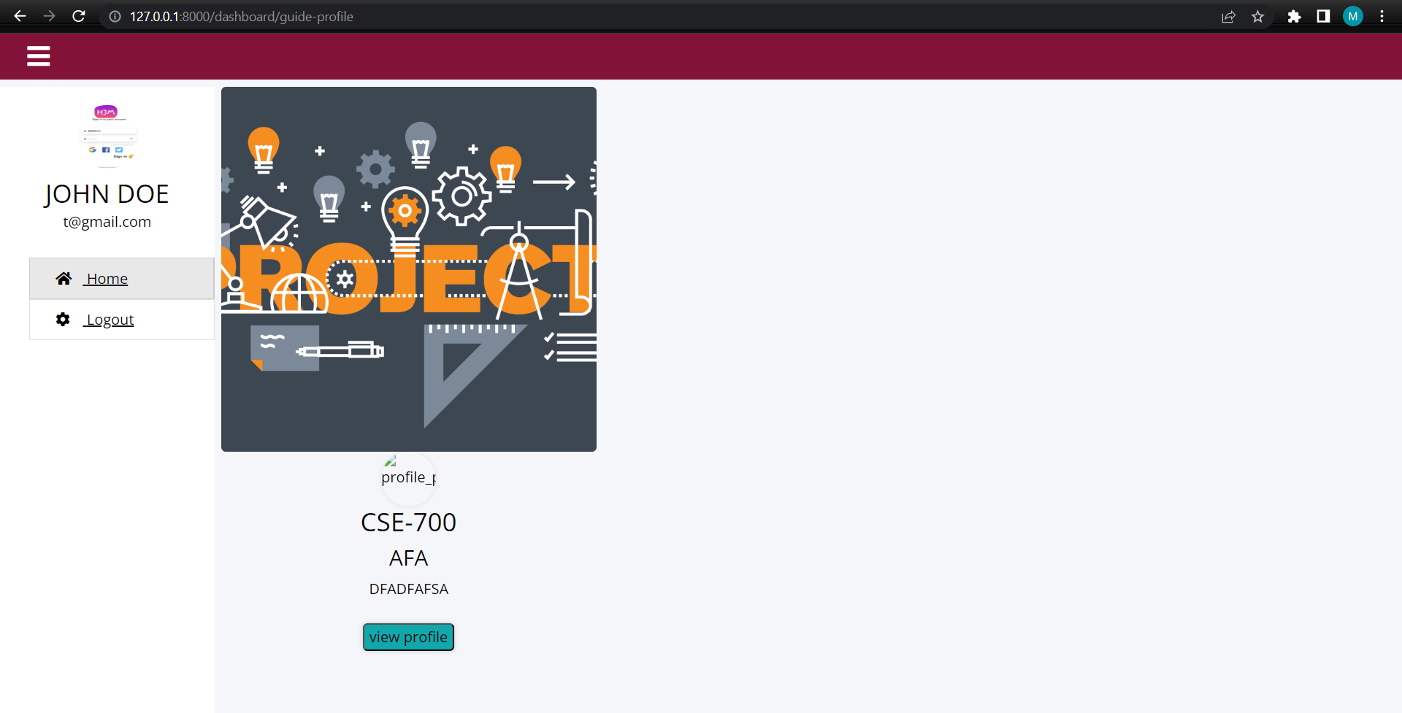
Application Screen shots

Slide 38
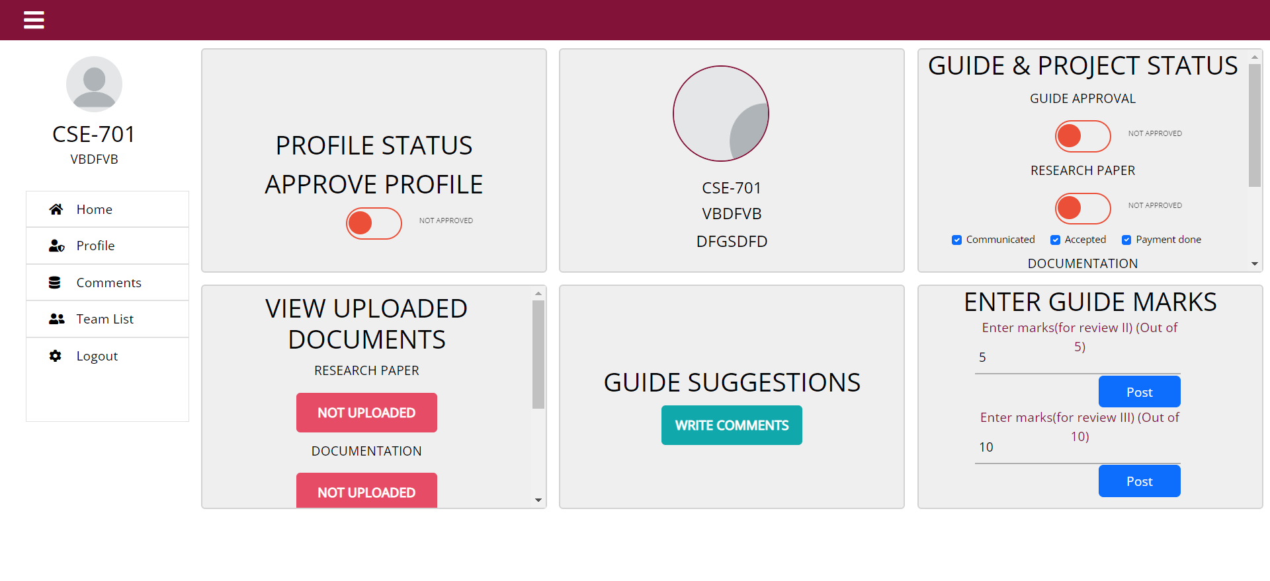
Application Screen shots

Slide 39
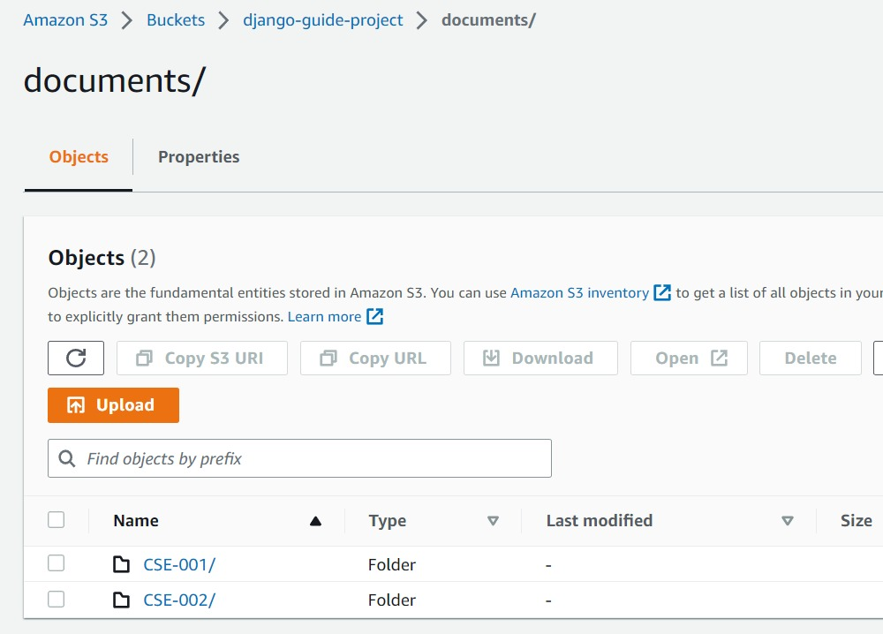
Application Screen shots

Slide 40
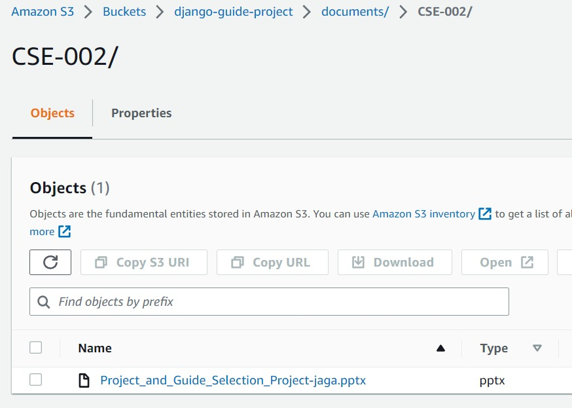
Application Screen shots

Slide 41
References
[1] Shahnawaz Alam, 2019, August.
https://ieeexplore.ieee.org/document/8843768
[2]EcoSys Team., 2018, October.
https://www.ecosys.net/blog/project-selection-prioritization-guide/#:~:text=What%20Is%20Project%20Selection%3F,determine%20the%20order%20of%20execution
[3] Simililearn, 2022, August.
https://www.simplilearn.com/project-management-apps-article
[4] W3Schools, for dropdowns
https://www.w3schools.com/howto/howto_js_cascading_dropdown.asp
[5] 7 Steps for Software Implementation Success, by Santex Group
https://santexgroup.com/blog/7-steps-for-software-implementation-success/
[6] Django Security Vulnerabilities fix:
https://stackoverflow.com/questions/52405589/how-to-check-django-security-vulnerabilities-and-how-to-fix-them

Slide 42

THANK YOU

